Slide 1
LOGGING FRAMEWORK
NGUYEN VAN NHUT

Slide 2
What is logging?
Why must use logging?
Log4j
Overview
Components
Architecture
Configuration
Implement on tools

Slide 3
What is logging?
Logging refers to automatically recording events and data structures about a software program's execution to provide an audit trail. Developers, testers and support personal are using the recorded information and data to identify software problems, to monitor live systems, for auditing purposes and post-deployment debugging.

Slide 4
Why must use logging?
To begin with, System.out.println outputs to standard output, which typically is a console window. The output from Logging can go to the console, but it can also go to an email server, a database table, a log file, or various other destinations.
you can configure via a configuration file. This means that you can change your logging configuration without requiring code updates.

Slide 5
log4j Overview
log4j is a reliable, fast and flexible logging framework (APIs) written in Java, which is distributed under the Apache Software License.
It views the logging process in terms of levels of priorities and offers mechanisms to direct logging information to a great variety of destinations, such as a database, file, console

Slide 6
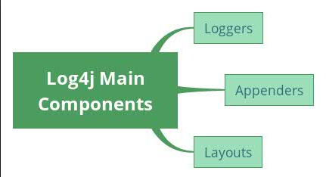
Log4j Components
loggers: Responsible for capturing logging information.
appenders: Responsible for publishing logging information to various preferred destinations.
layouts: Responsible for formatting logging information in different styles.

Slide 7
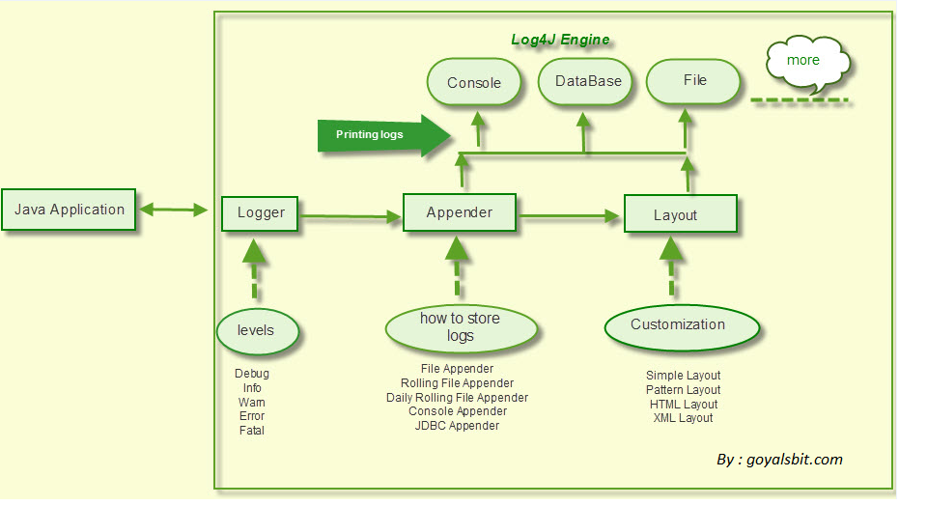
Log4j- components(cont)

Slide 8
log4j - Architecture
There are two types of objects available with log4j framework.
Core Objects: These are mandatory objects of the framework. They are required to use the framework.
Support Objects: These are optional objects of the framework. They support core objects to perform additional but important tasks.

Slide 9
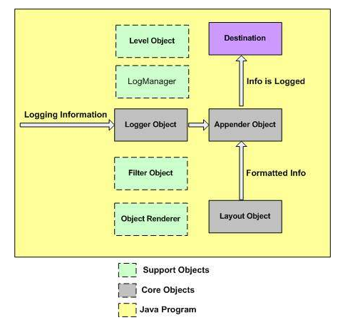
log4j – Architecture(cont)
Figure:

Slide 10
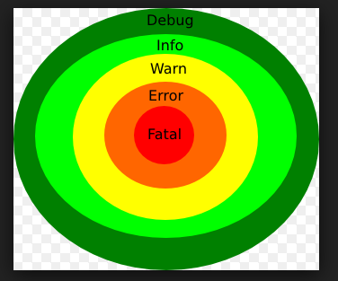
Logging levels

Slide 11
log4j - Logging Methods
Logger class provides a variety of methods to handle logging activities. The Logger class does not allow us to instantiate a new Logger instance but it provides two static methods for obtaining a Logger object −
public static Logger getRootLogger();
public static Logger getLogger(String name);

Slide 12
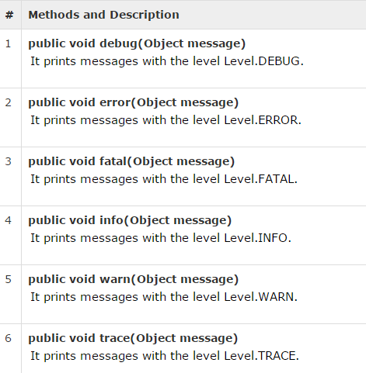
log4j - Logging Methods

Slide 13
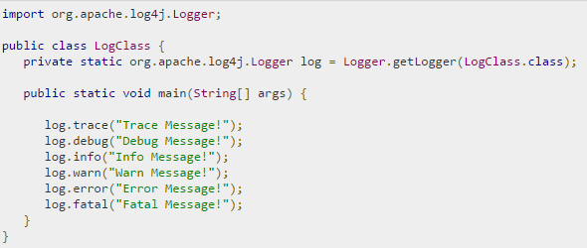
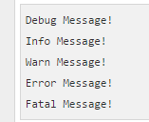
log4j - Logging Methods(CONT)
Example:

Slide 14
Configuration
The log4j.properties file is a log4j configuration file which keeps properties in key-value pairs. By default, the LogManager looks for a file namedlog4j.properties in the CLASSPATH.
The level of the root logger is defined as DEBUG. The DEBUG attaches the appender named X to it.
Set the appender named X to be a valid appender.
Set the layout for the appender X.

Slide 15
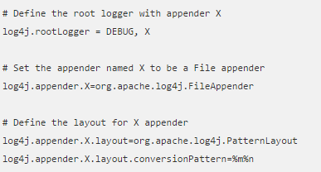
Configuration(CONT)
Log4j.properties

Slide 16
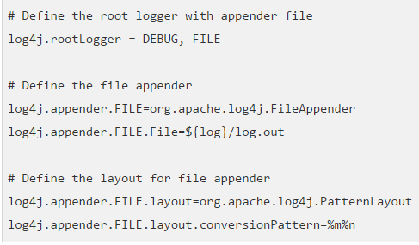
Configuration(CONT)
Example: log to file

Slide 17

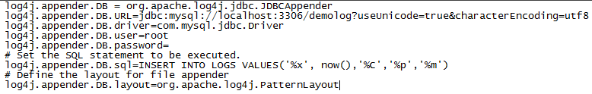
Configuration(CONT)
Example: log to console
Example: log to database

Slide 18
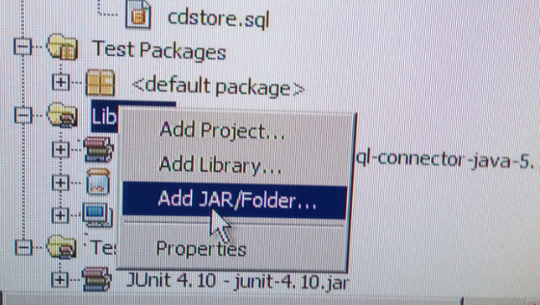
IMPLEMENT ON NETBEANS
Add library

Slide 19
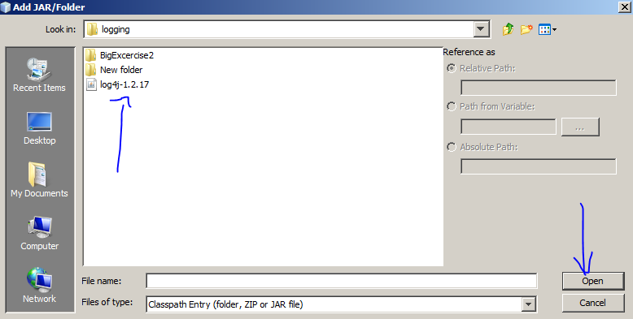
Path library

Slide 20
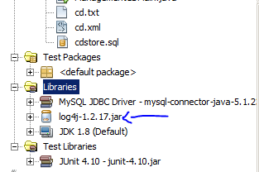
Add library result

Slide 21
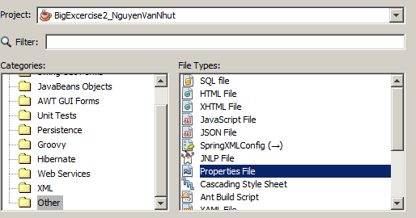
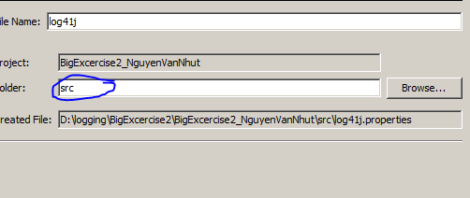
Log4j - Configuration
Create new proberties file

Slide 22
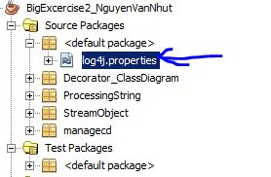
Result of creating proberties file

Slide 23

Main structure
There are two main components
Logger
Appender

Slide 24
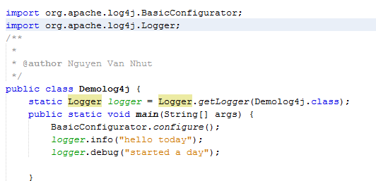

LOG4J INITIALIZE
Initialization code
Results:

Slide 25
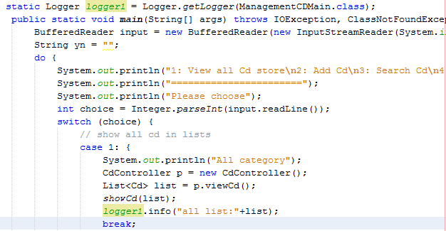
LOG4J INITIALIZE
Initialization code and using proberties

Slide 26
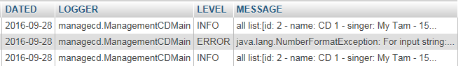
Result

Slide 27
REFERENCE
http://logging.apache.org/log4j/2.x/
http://www.tutorialspoint.com/log4j/

